Slide 1
Evaluation and improvement of a dual-channel method for the detection and quantification of high-temperature events on FireBIRD data
Penghua Li
November 30, 2017

Slide 2
Contents
Introduction and motivation
Introduction of MITIP, an atmospheric correction and image processing method
Short description of MITIP
Data preparation and pre-processing
Outcomes of the MITIP
Validation and improvement of the MITIP
Results comparison with MODIS SST and calibration
Transferability test (SST)
Results comparison with MODIS LST and calibration
Transferability test (LST)
Analysis of high-temperature events
High-temperature events
Comparison with the results of Zhukov’s algorithm
Conclusion and outlook

Slide 3
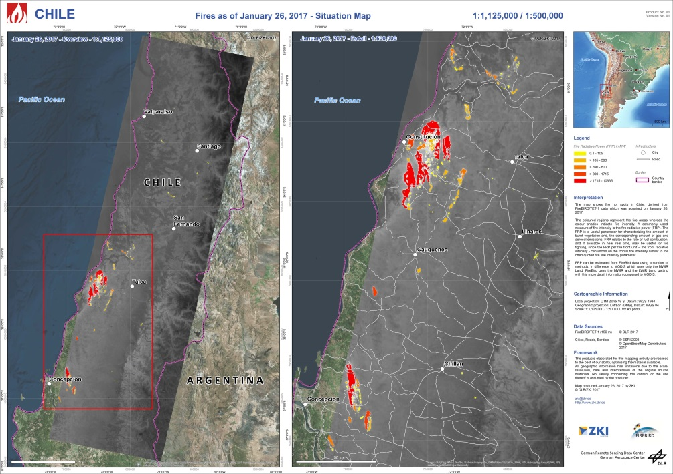
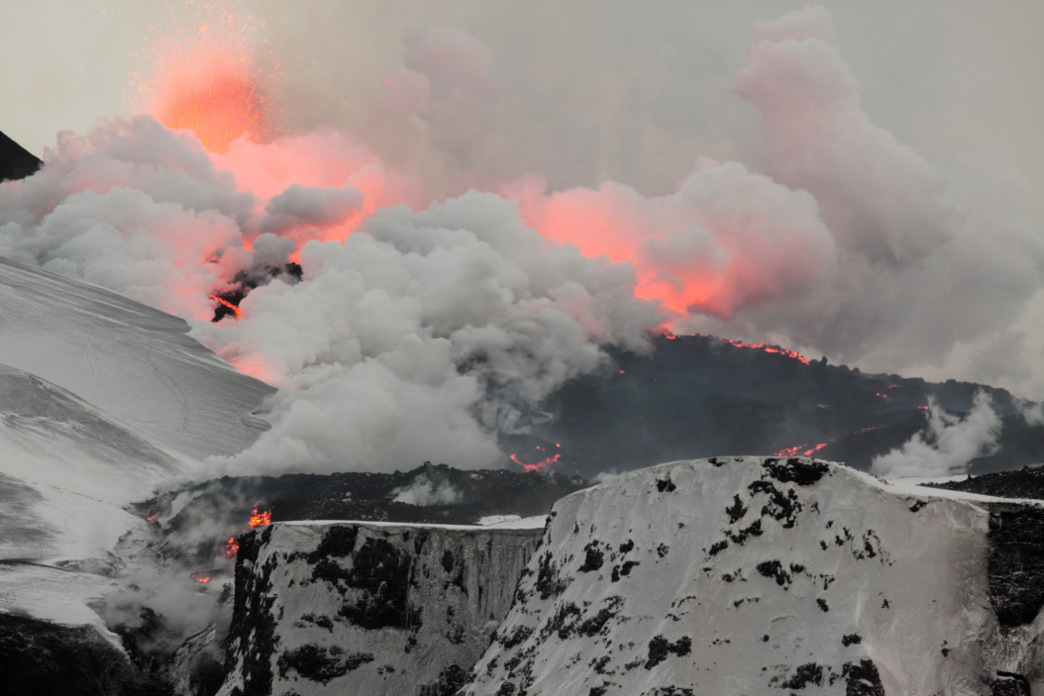
1. Introduction and motivation
High-temperature events (HTE) : occur worldwide
exert great impacts on the environment.
Huge affected areas
The potentially dangerous characteristics
Satellite remote sensing
Chile wild fire
2010 eruptions of Eyjafjallajökull

Slide 4
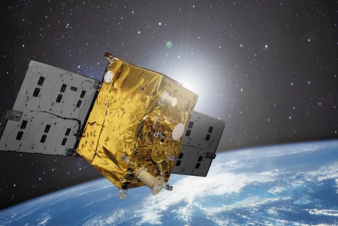
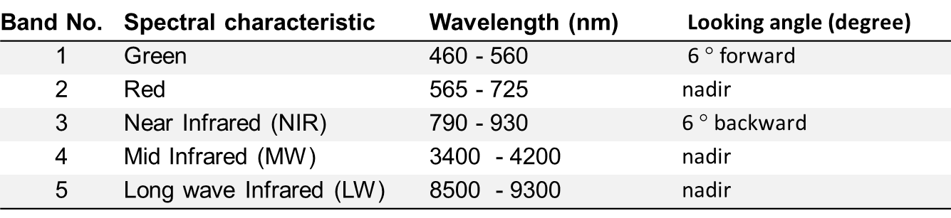
1. Introduction and motivation
FireBIRD satllite
Constellation of 2 tilting satellites :
TET-1 (launch July 2012),
BIROS (launch June 2016)
Orbit (sun-sychronus)
TET-1: 438 km (asc.), LTAN 13:50 UCT
BIROS: 510 km (desc.), LTAN 21:40 UCT
Sensors:
2 Infrared cameras with staggered detectors
One 3-channel VIS/ NIR - camera

Slide 5
2. Introduction of MITIP, an atmospheric correction and image processing method
The MITIP method is an atmospheric correction and image processing method developed by Dr. Rudolf at DLR, which is used for processing the thermal remote sensing imageries of the FireBIRD satellite.
Input data
Temperature retrieval
sub-pixel resolution temperature determination
Atmospheric correction
hot spot detection and quantification

Slide 6
2. 2 Data preparation and pre-processing
Input of MITIP
TET-1 imagery with MIR and TIR band
ASTER Global Elevation Models
ASTER Global Emissivity Database
MODIS water vapor file
Requirement
Overlap
Same pixel size
Same num. of rows and col.
Pre-processing
Convert to GeoTIFF and re-project to appropriate UTM zone
Resampling to pixel size 150 * 150
Using TET-1 scene as a mask to clip other imageries

Slide 7
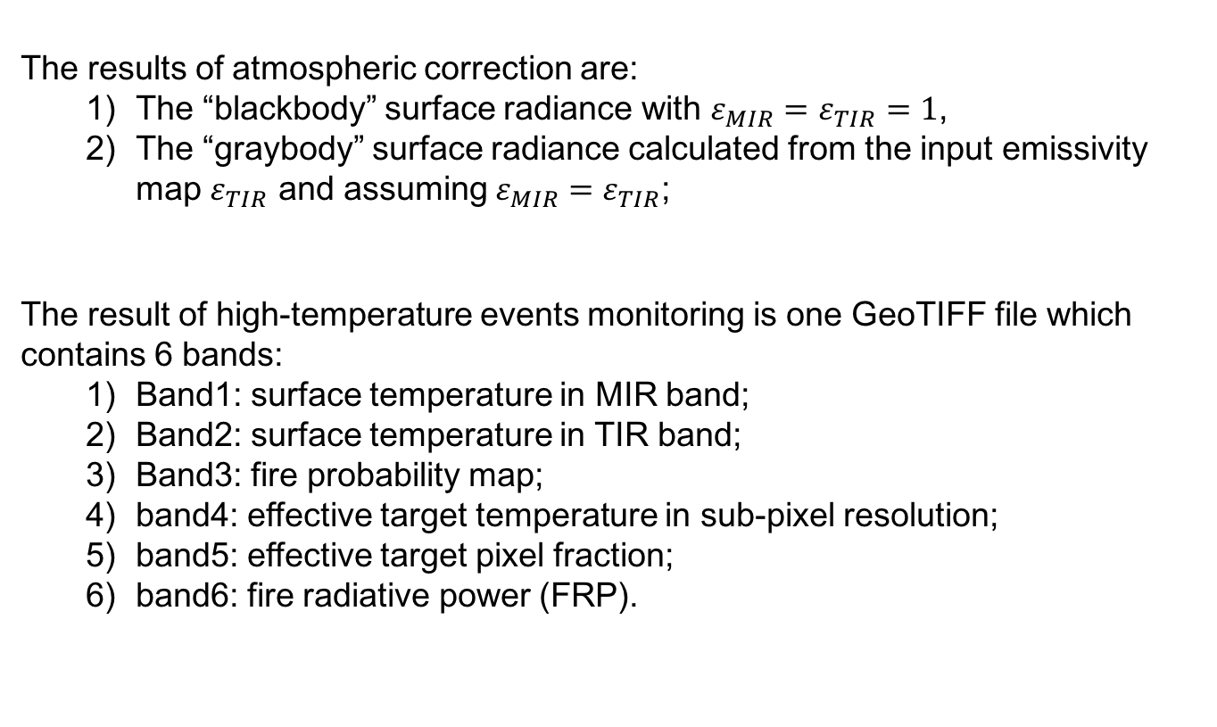
2. 3 Outcomes of the MITIP
The results of atmospheric correction are:
The “blackbody” surface radiance with $ε_{MIR}=ε_{TIR}=1$,
The “graybody” surface radiance calculated from the input emissivity map $ε_{TIR}$ and assuming $ε_{MIR}=ε_{TIR}$;
The result of high-temperature events monitoring is one GeoTIFF file which contains 6 bands:
Band1: surface temperature in MIR band;
Band2: surface temperature in TIR band;
Band3: fire probability map;
band4: effective target temperature in sub-pixel resolution;
band5: effective target pixel fraction;
band6: fire radiative power (FRP).

Slide 8
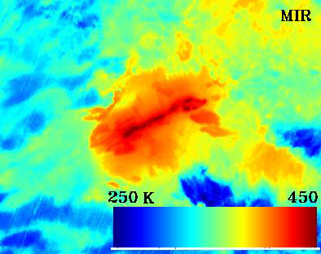
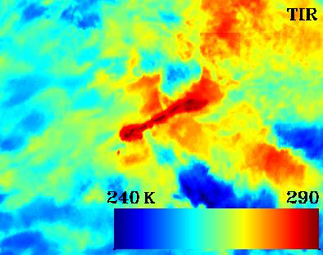
2. 3 Outcomes of the MITIP
Example: Bardarbunga 2014.09.14
Surface temperature map (MIR)
Surface temperature map (TIR)

Slide 9
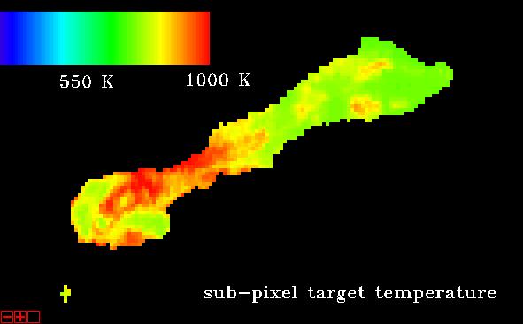
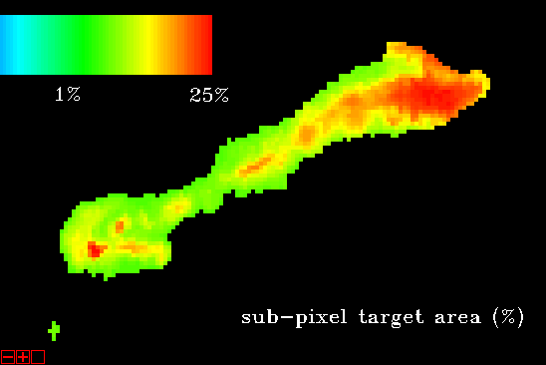
2. 3 Outcomes of the MITIP

Slide 10
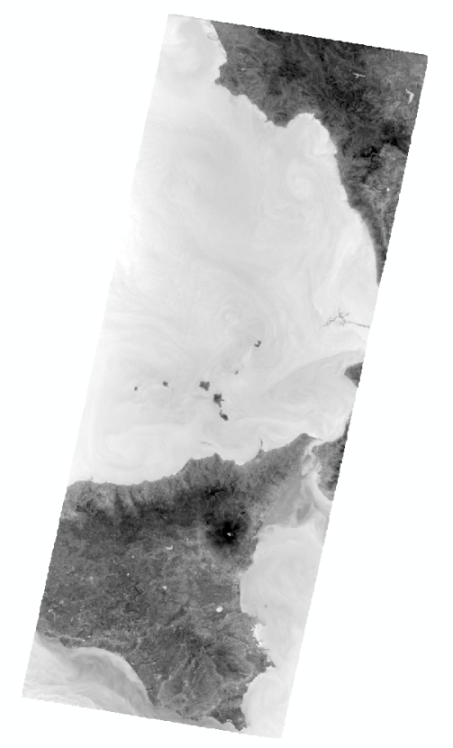
3. Validation and improvement of the MITIP
Compare the results from MITIP with MODIS temperature products, namely MODIS Sea Surface Temperature (SST) to see whether they are reliable or not.
Select Etna whose imagery is mainly covered by sea as the test site.
Etna:

Slide 11
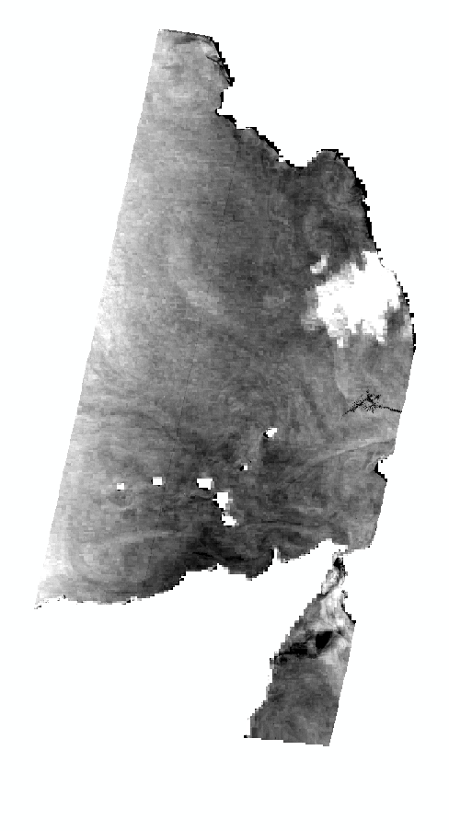
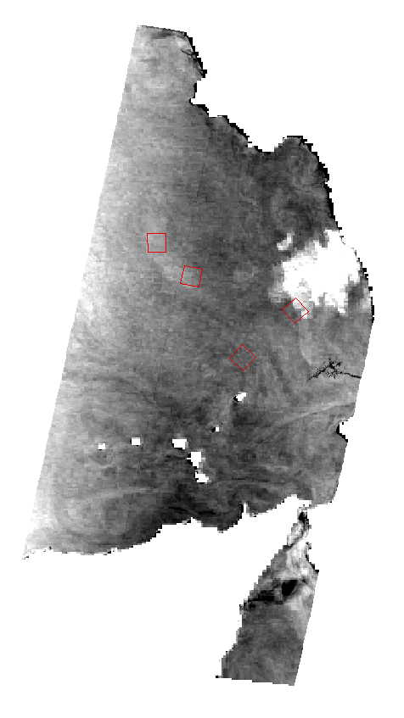
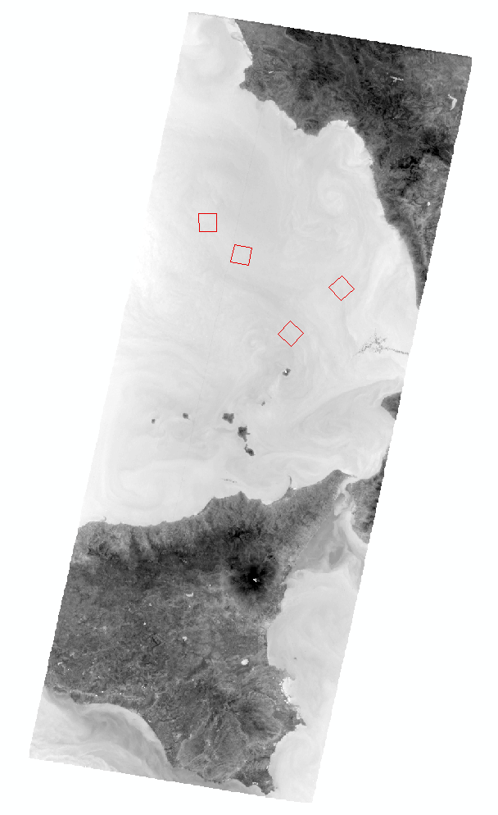
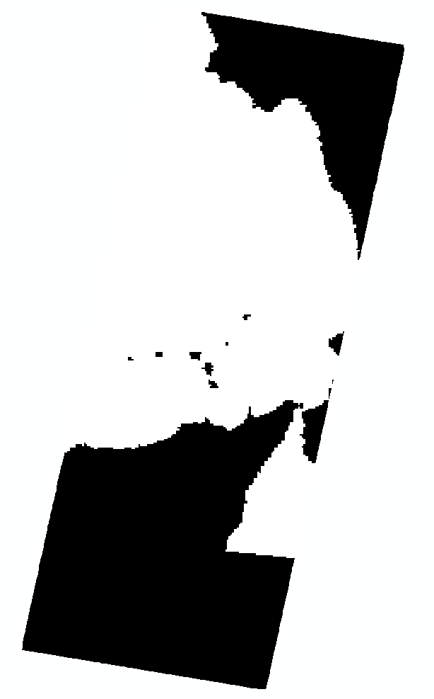
3. Validation and improvement of the MITIP
The comparisons are done as follows (Etna as example):
4
5
Outliers are filtered out and mean temperature difference calculation.
Computing mean temperature differences over all sub-areas.
Pre-processing of the MODIS SST
1
2
Image subtraction
3
Selection of several (3 – 5) sub-areas.

Slide 12
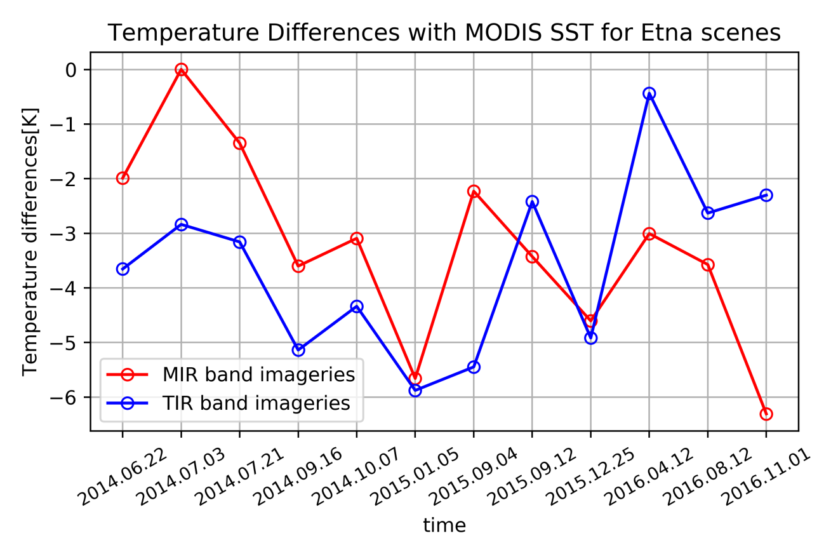
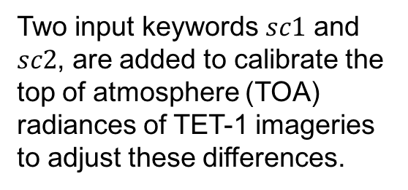
3.1 Results comparison with MODIS SST and calibration
Firstly, the temperature results from MITIP are compared with MODIS SST.
Two input keywords $sc1$ and $sc2$, are added to calibrate the top of atmosphere (TOA) radiances of TET-1 imageries to adjust these differences.

Slide 13
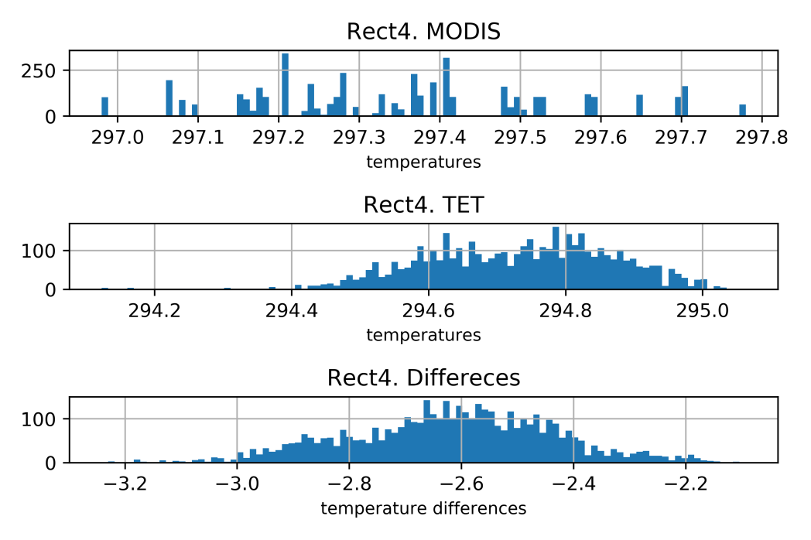
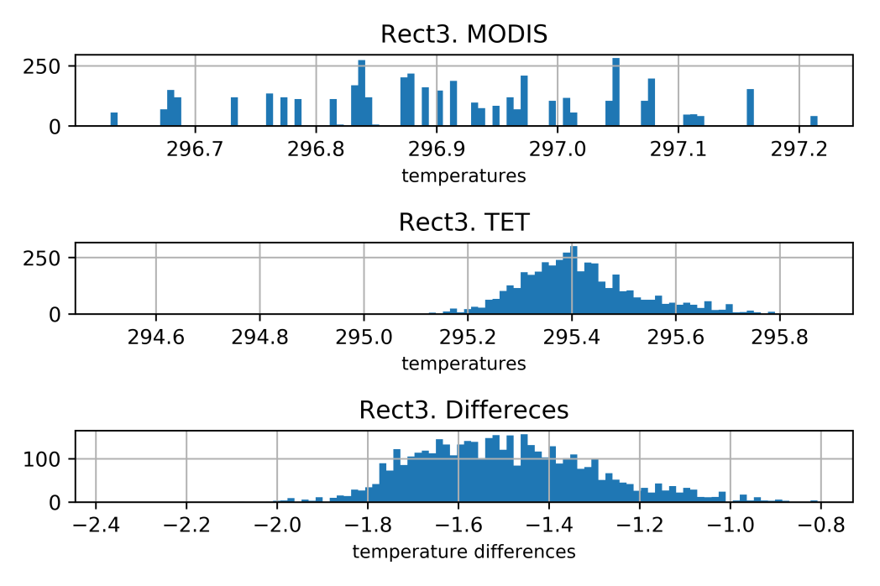
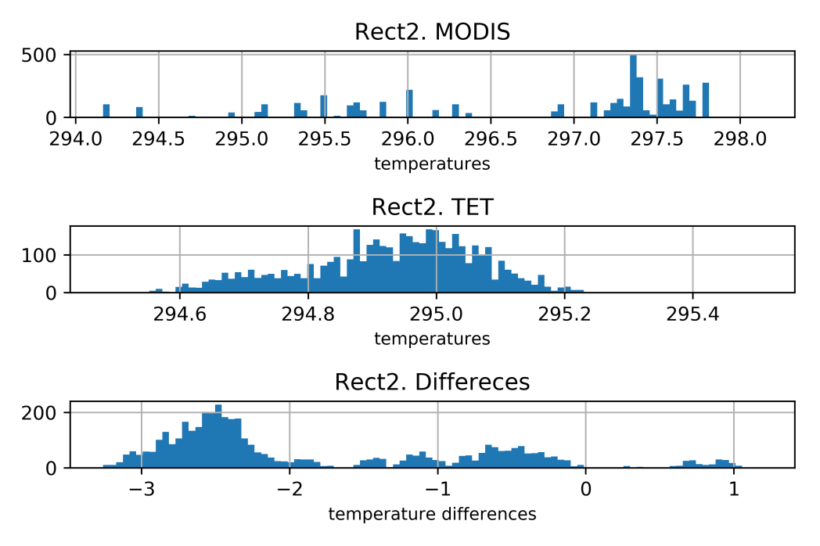
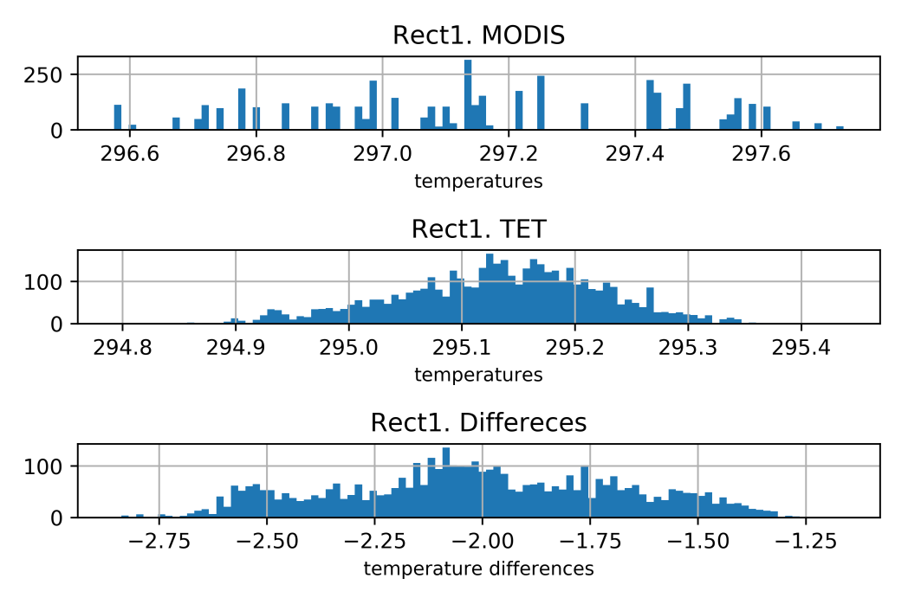
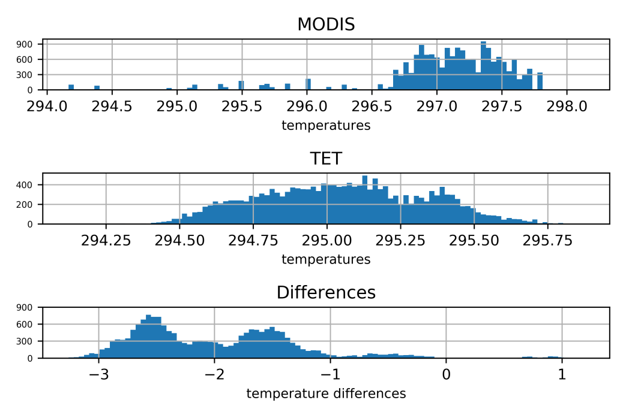
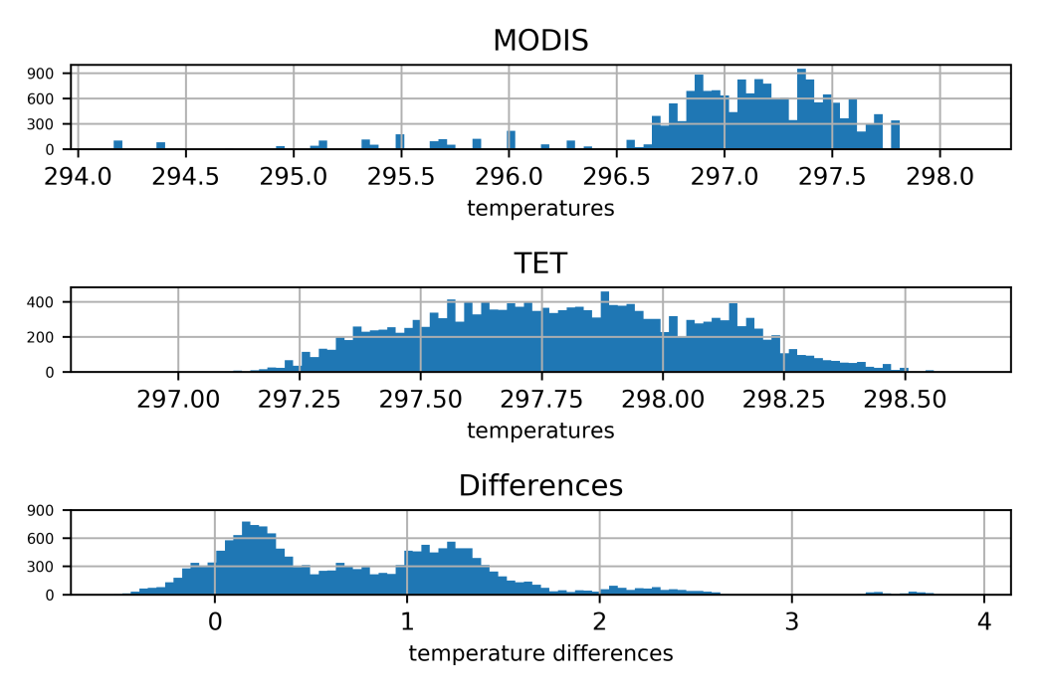


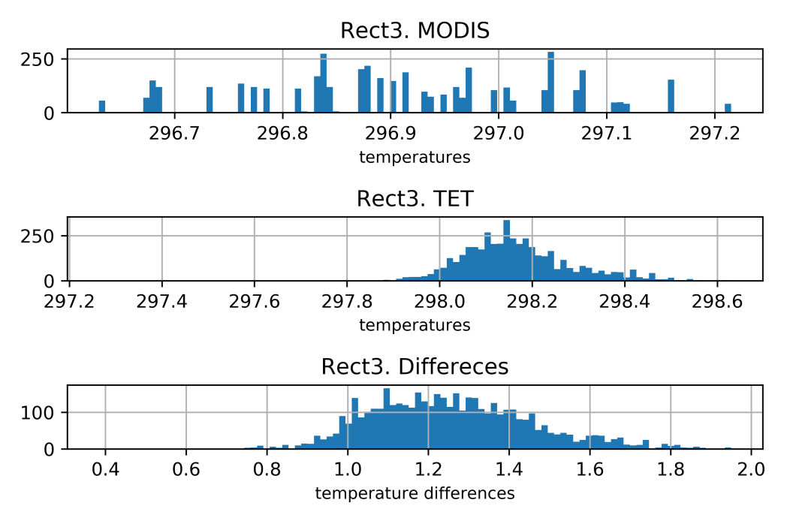
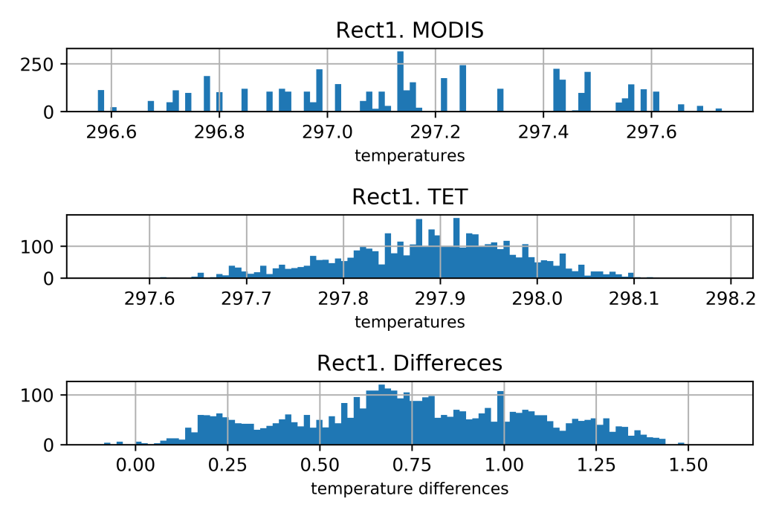
3.1 Results comparison with MODIS SST and calibration
Five scale factors are selected, namely 1.00 (original TOA radiances), 1.05 (increase the TOA radiances by 5%), 1.10, 1.15, 1.20, for each band.
Scale factor 1.00
The histograms of the sub-areas are investigate to see the effect of the scale factors.
Scale factor 1.10

Slide 14
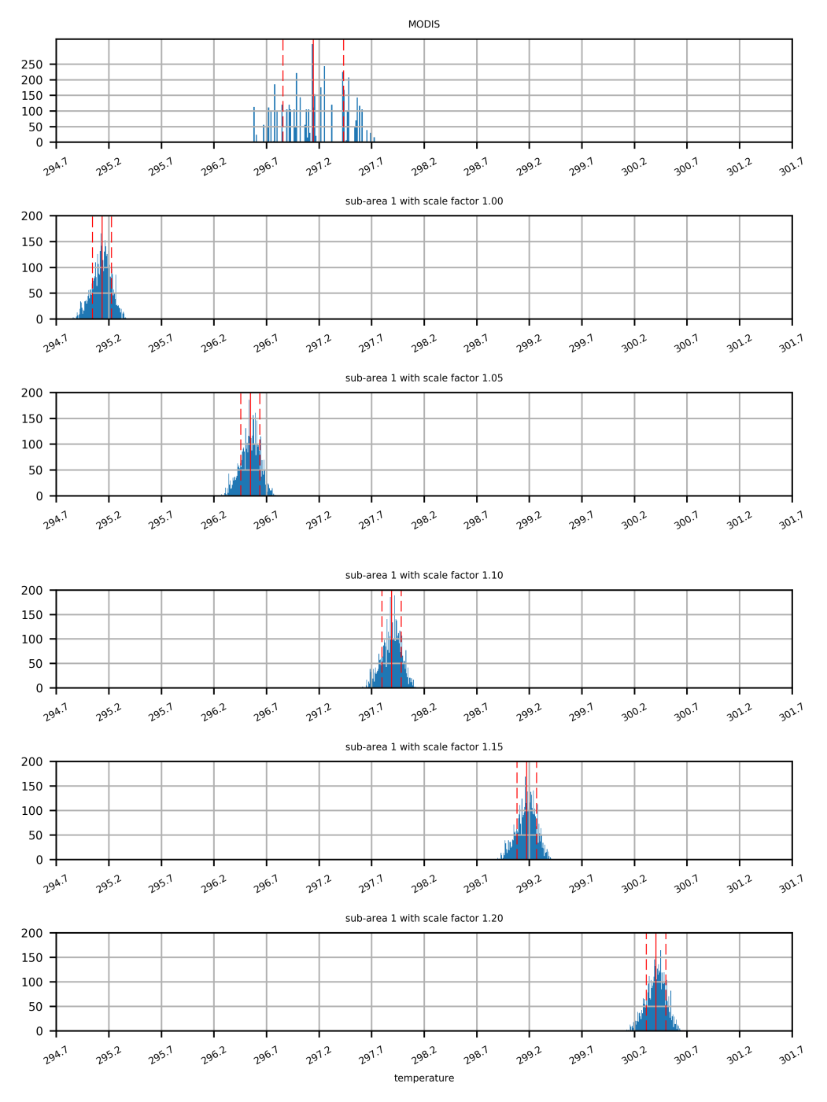
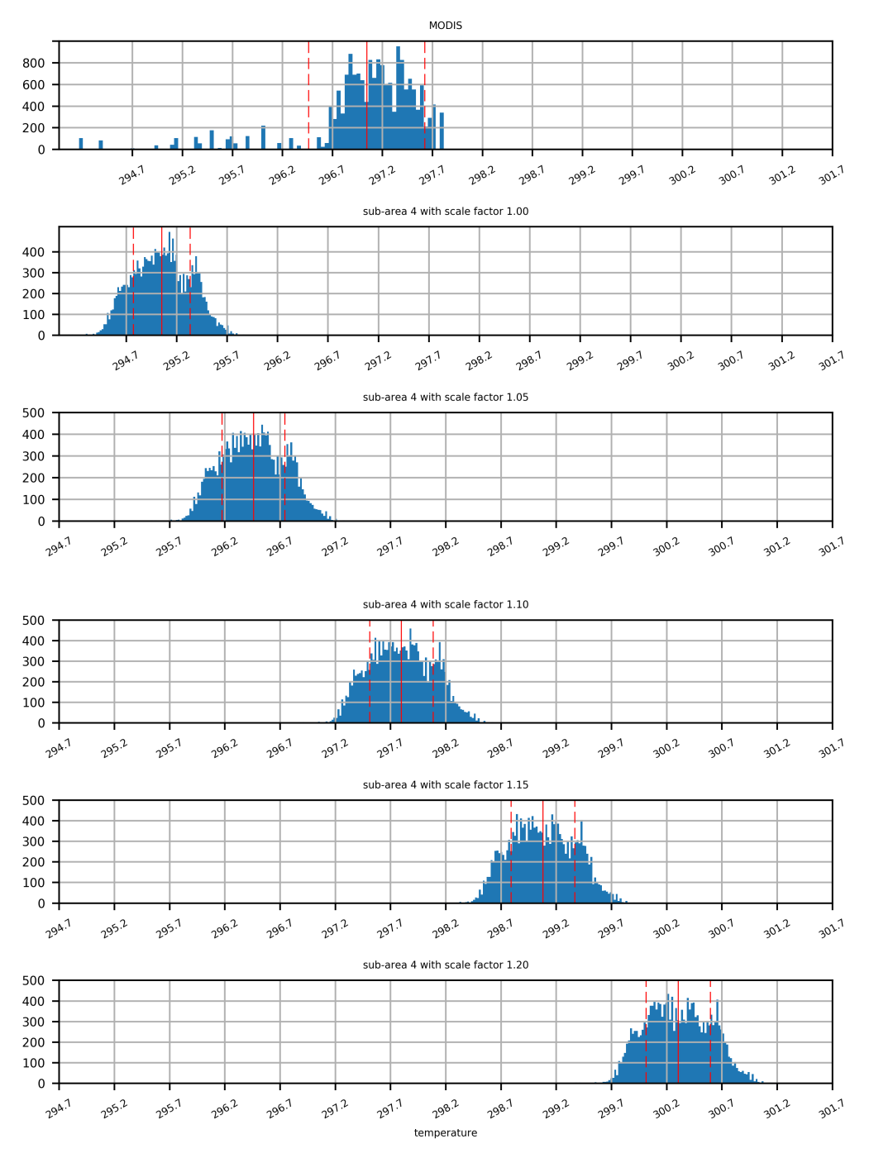
3.1 Results comparison with MODIS SST and calibration
The histograms of sub-area 1 and sub-area 4 with all the five scale factors are shown on the right.
The histogram of all pixels inside the 4 sub-areas are plotted.
Sub-area 1
Sub-area All

Slide 15
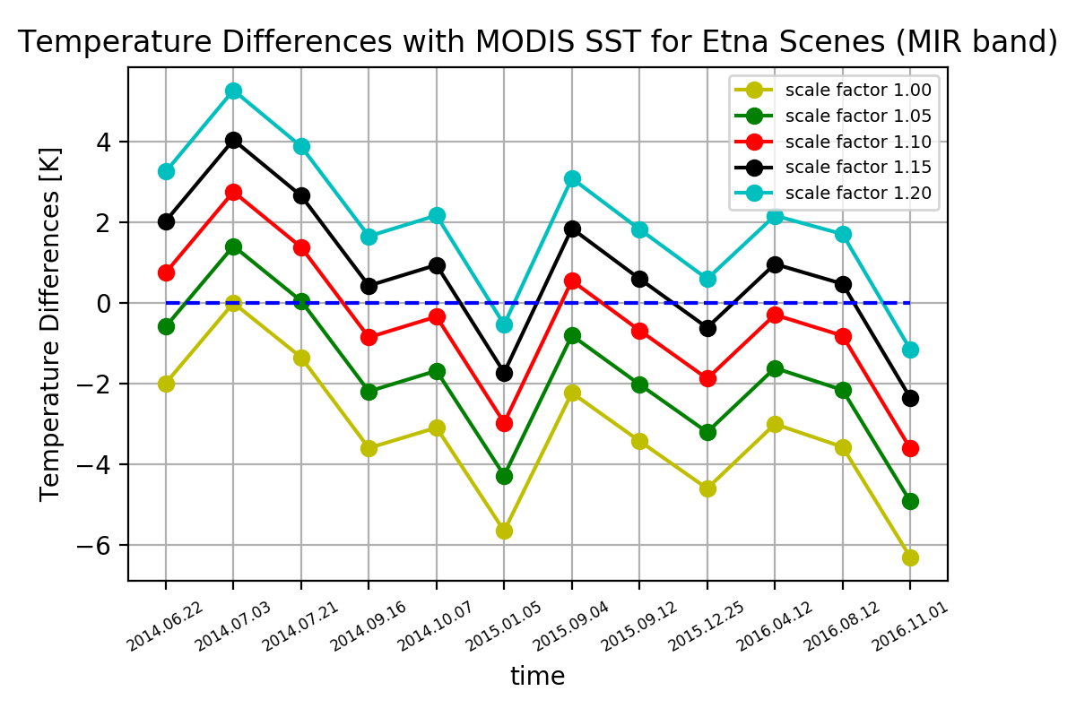
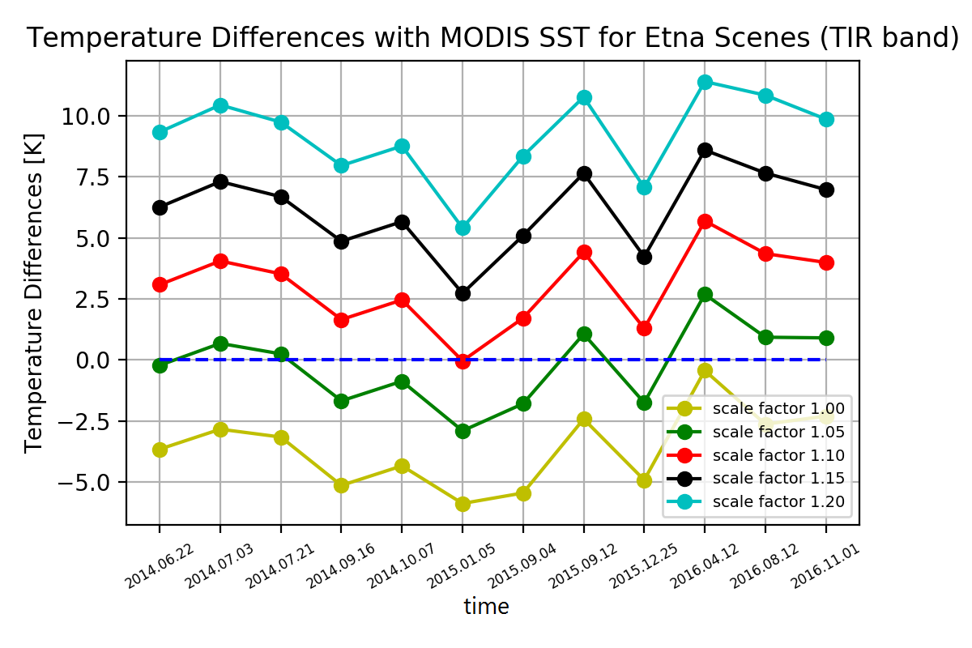
3.1 Results comparison with MODIS SST and calibration
The mean temperature difference over all the sub-areas is able to represent the temperature differences.
So in order to determine the optimal scale through time-series analyses, the method presented before which computes the mean temperature difference over all selected sub-areas are used.

Slide 16
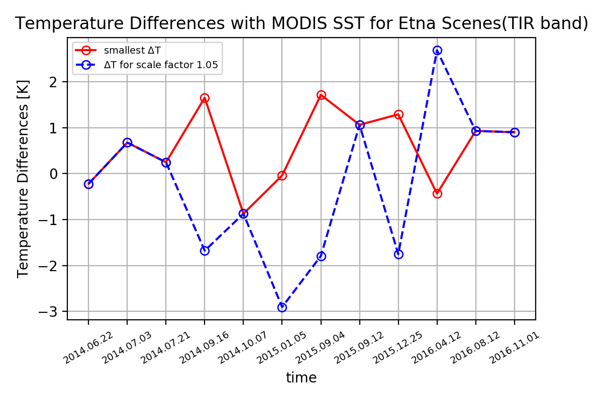
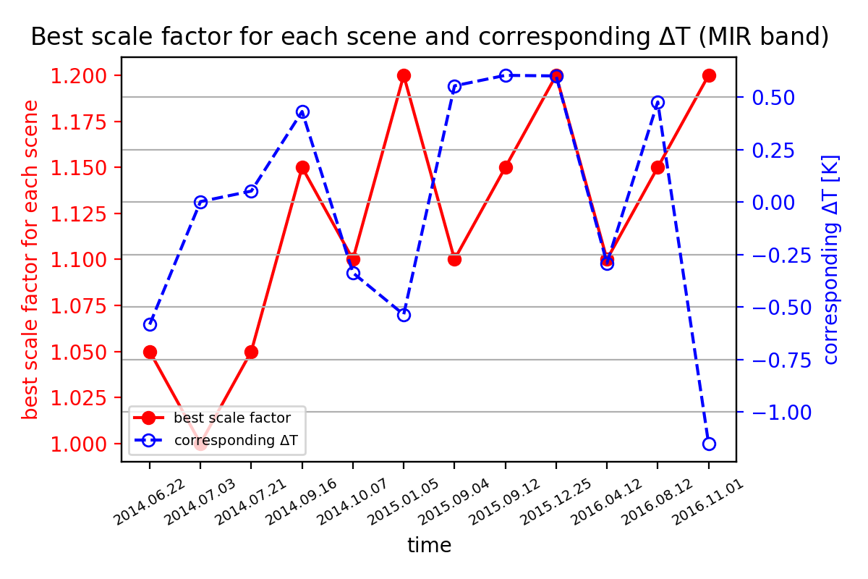
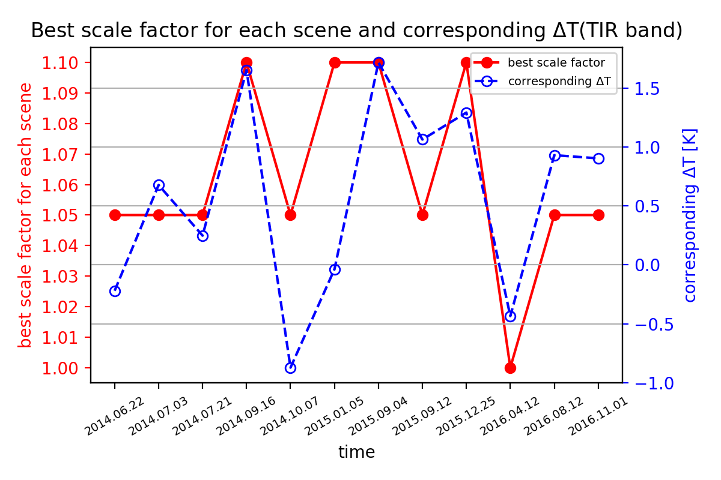
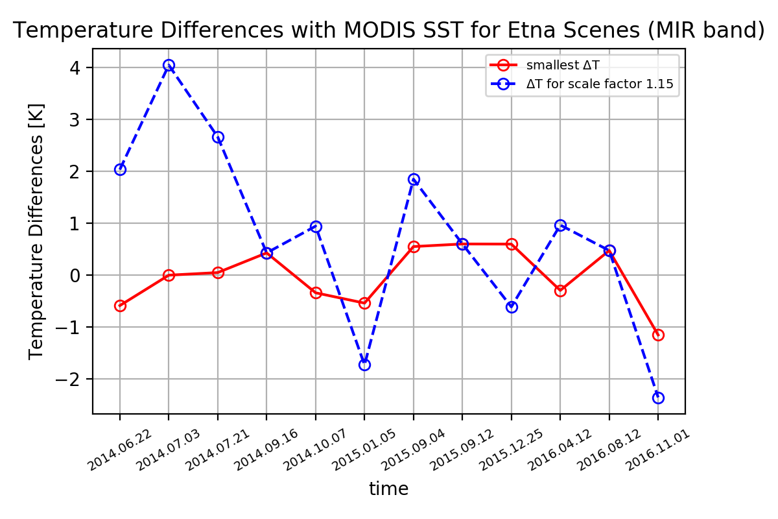

3.1 Results comparison with MODIS SST and calibration
The optimal scale factor for each band and its corresponding temperature difference $∆T$ is showed below.
According to the comparison results and analyses, the optimal scale factor for MIR band is chosen as 1.15 and for TIR band1.05.

Slide 17
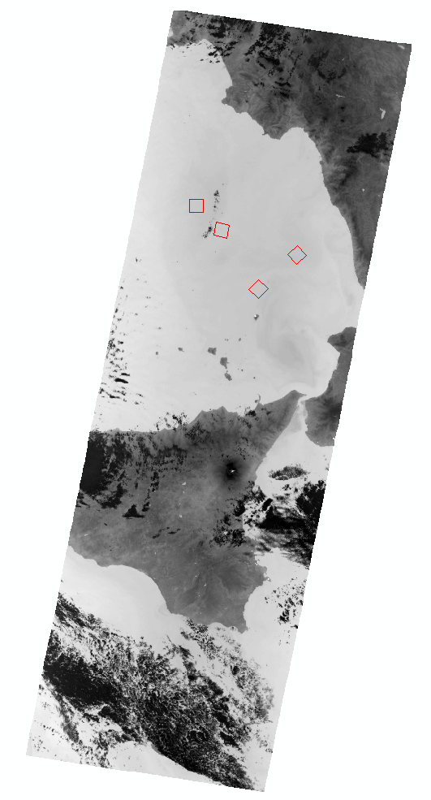
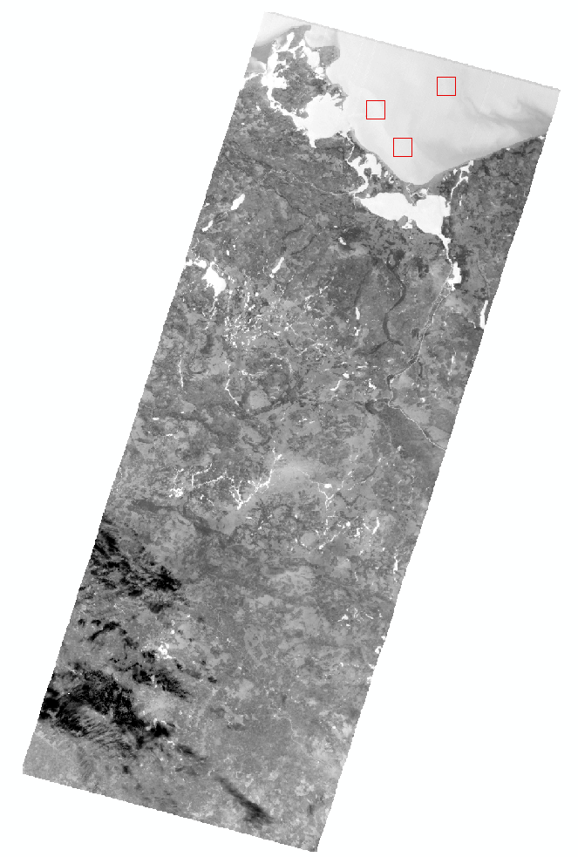
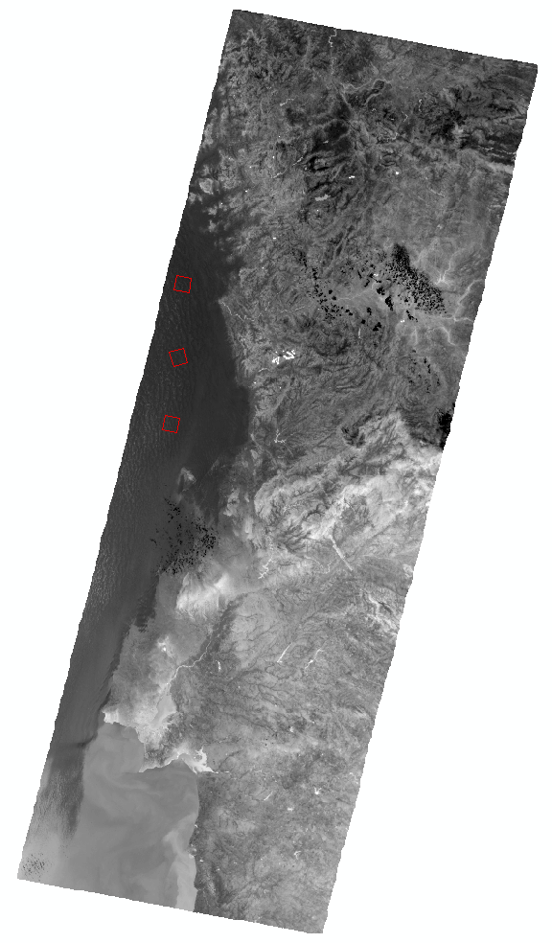
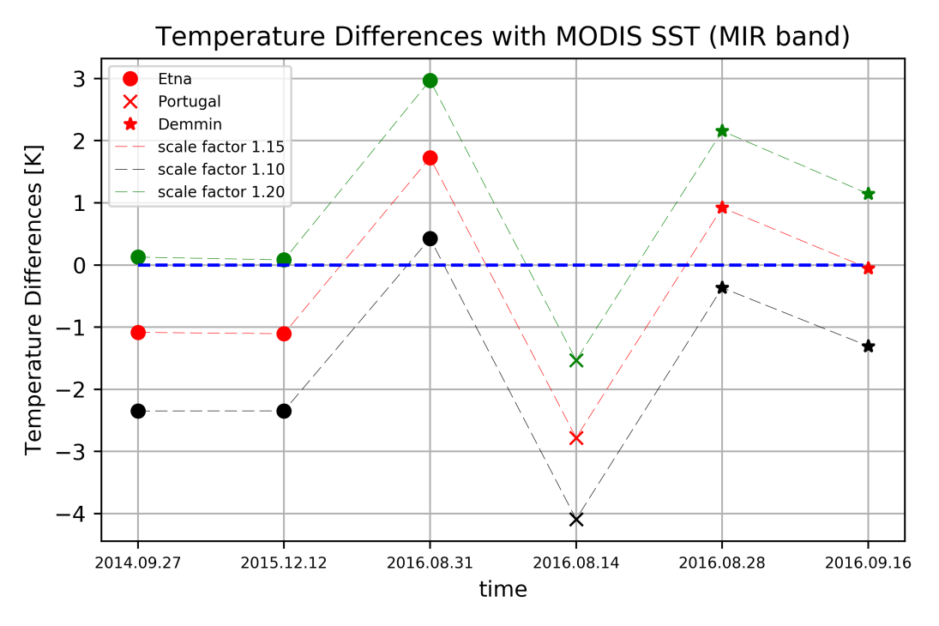
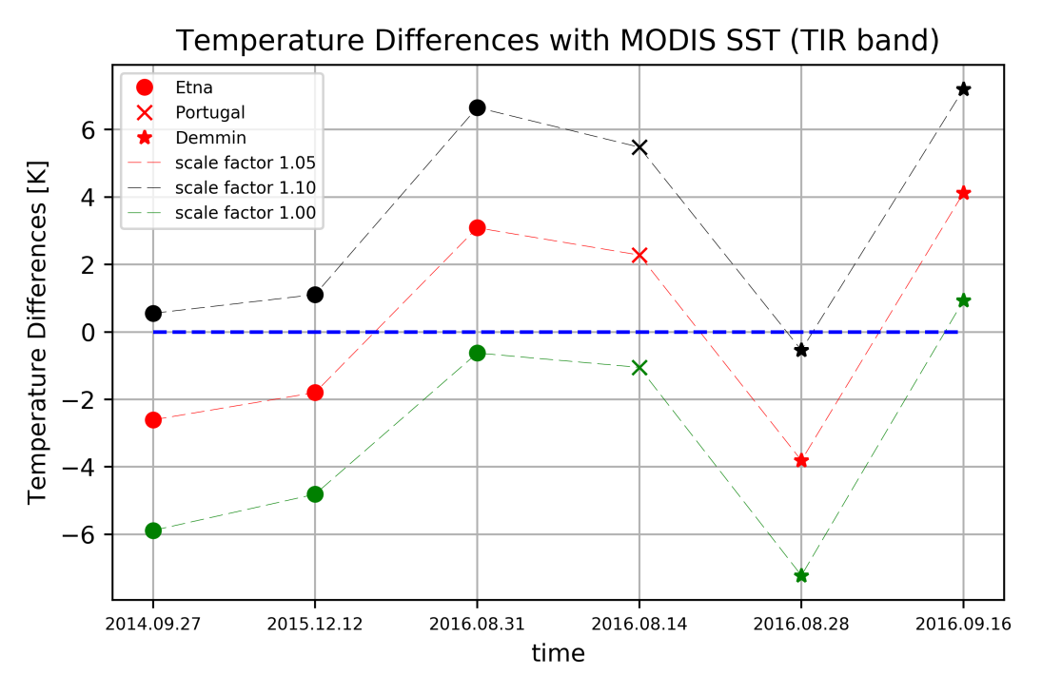
3.2 Transferability test (SST)
The chosen scale factor should be tested with different TET-1 imageries. Here, it is tested using scenes of Etna, Demmin and Portugal as showed bellow.

Slide 18
4. Analysis of high-temperature events
Optimal scale factor:
1.15 for MIR band imagery;
1.05 for TIR band imagery.
Now, we are able to analyse the performances of MITIP on the monitoring of high-temperature events (HTE).
Firstly the results of the MITIP of the high-temperature monitoring is presented.

Slide 19
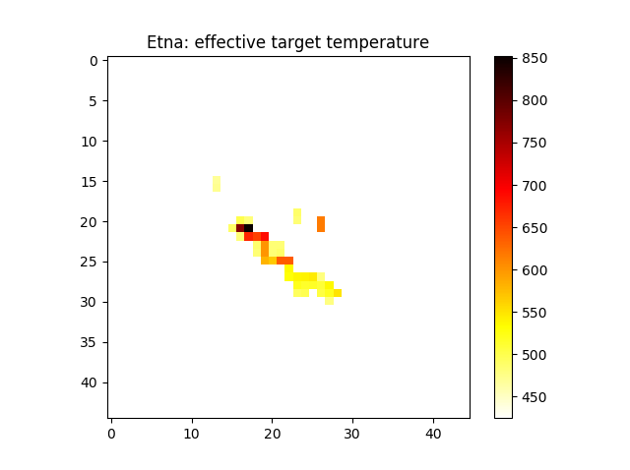
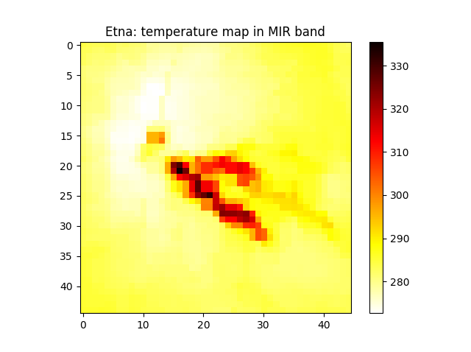
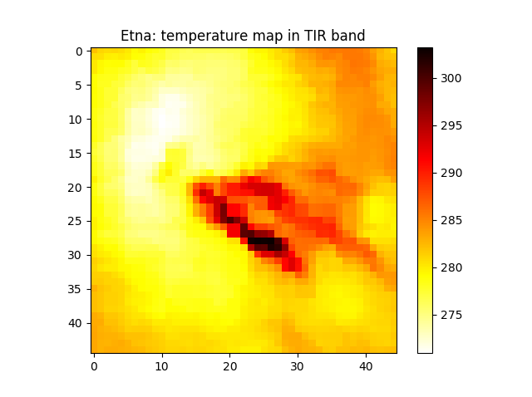
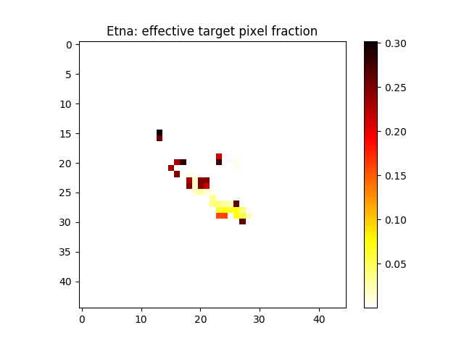
4.1 High-temperature events
Etna 2014.06.22

Slide 20
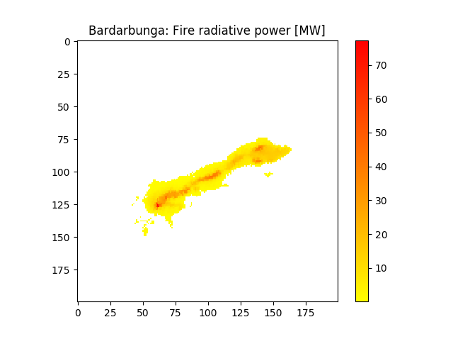
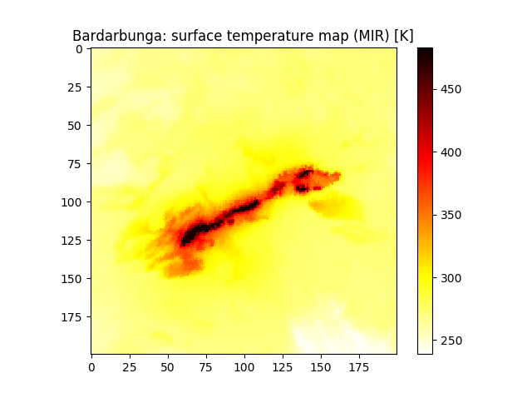
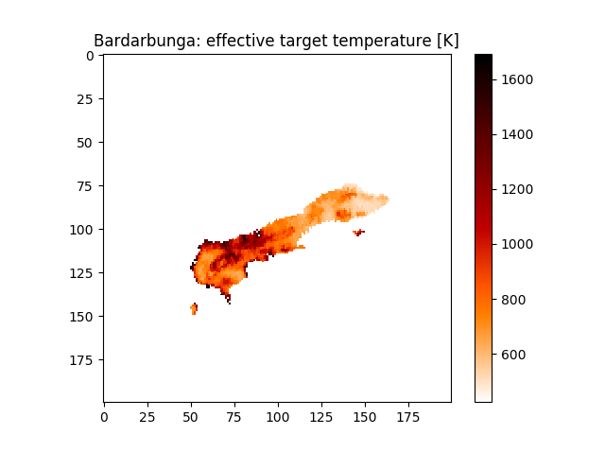
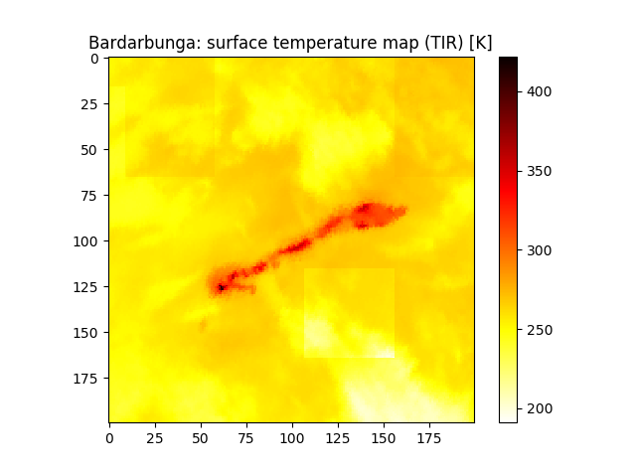
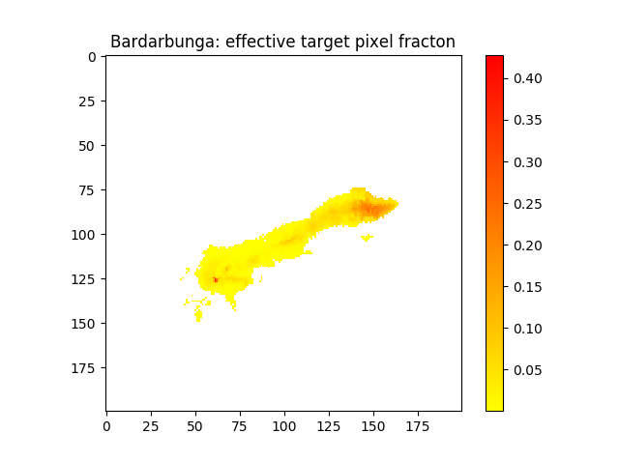
4.1 High-temperature events
Bardargunga 2014.09.14

Slide 21
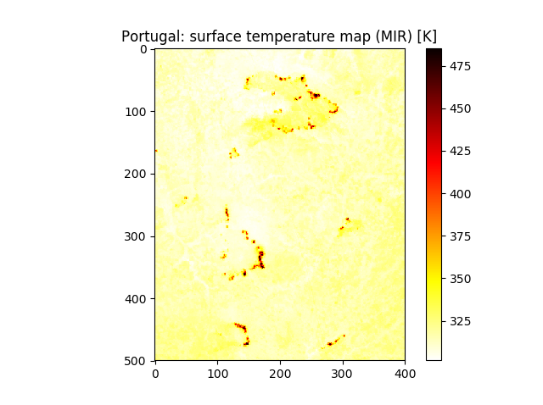
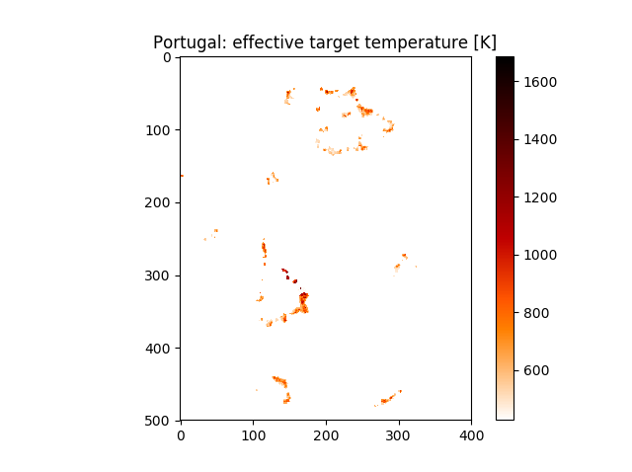
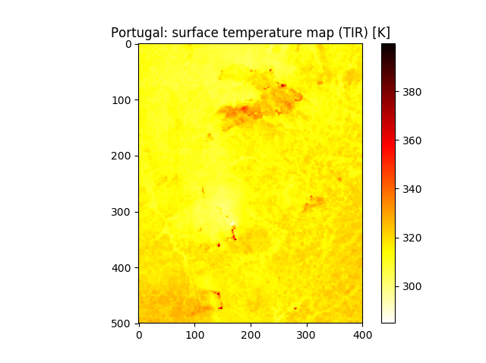
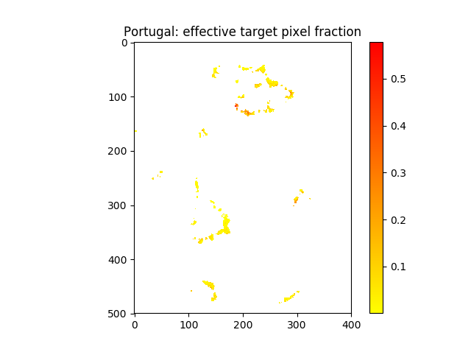
4.1 High-temperature events
Portugal 2016.08.11

Slide 22
4.2 Comparison with the results of Zhukov’s algorithm
The Zhukov’s algorithm is the algorithm used to process the TET-1 imagery originally.
Atmospheric correction
threshold determination
cluster-based analysis
filtering out clouds, warm surface etc
Hot pixels detection
But the MITIP method performs a pixel-based analysis.
To do the comparison, a procedure is developed to shift the MITIP’s original pixel-based results to cluster-based results.
Input fire products
Extract every polygon feature
Extract AOI
Convert effect target temperature to a vector file
Create mask file
Zonal statistics

Slide 23

4.2 Comparison with the results of Zhukov’s algorithm
Etna 2014.07.21
Method | Temperature [K] |  |  | Cluster size
Zhukov | Min | Mean | Max | 127
 | 611 | 633.5 | 661.3
MITIP | 644.3 |  |  | 123

Slide 24

4.2 Comparison with the results of Zhukov’s algorithm
Stromboli 2014.07.03
Method | Temperature [K] |  |  | Cluster size
Zhukov | Min | Mean | Max | 16
 | 504.6 | 529.9 | 564.9
MITIP | 521.0 |  |  | 20

Slide 25

4.2 Comparison with the results of Zhukov’s algorithm
Bardarbunga 2014.09.14
method | Temperature [K] |  |  | Cluster size
Zhukov | Min | Mean | Max | 2461
 | 646 | 653.8 | 662
MITIP | 661.3 |  |  | 2025

Slide 26


4.2 Comparison with the results of Zhukov’s algorithm
Chile 2017.01.26
Loc | Method | Temperature [K] |  |  |  |  |  |  |  | Cluster size
a | Zhukov | Min |  | Mean |  |  |  | Max |  | 1804
 |  | 635.2 |  | 641.4 |  |  |  | 648.1
 | MITIP | 656.7 |  |  |  |  |  |  |  | 2046
b | Zhukov | Min |  |  | Mean |  | Max |  |  | 3846
 |  | 617.6 |  |  | 626.9 |  | 637
 | MITIP | 602.0 |  |  |  |  |  |  |  | 4500
c | Zhukov |  | Min |  |  | Mean |  |  | Max | 3863
 |  | c1 | 612 |  |  | 615.2 |  |  | 618.5
 |  |  |  |  |  |  |  |  |  | 3185
 |  | c2 | 612.9 |  |  | 619.9 |  |  | 627.5
 | MITIP | 625.0 |  |  |  |  |  |  |  | 7829

Slide 27
5. Conclusion and outlook
Conclusion
The MITIP methods shows high capacities in high-temperature events detection and quantification.
It is a near real-time semi-operational detection system for thermal anomalies.
Outlook
Expansion the MITIP method to process the day-time scenes of TET-1 with the help of the red-band imagery is undergoing.
Combination with Zhukov’s algorithm by using its hot spot detection method.

Slide 28
The end.
Thank you!

